Slide 1
Matatu management system
Members:
Benson Maina
Kenneth Mugambi
Kiprono Fredrick

Slide 2
Problem statement
The current matatu systems in place is not that efficient
We note that
manual record of tickets this incur other requirements e.g. where to store these record books and safely.
Arrival and departure of matatus is also done manually through writing these on a chalkboard for the operators to when to leave and the route to take, this is outdated.
There is no proper management of staff.
Fares are only identifiable at stages/stations.
We intend to design a matatu system that will try and make all this processes as fast and efficient as possible to solve in a way minimizing costs and increase income generated.

Slide 3
Software requirement specification General description
Product description
The matatu system is a computerized system that will help all the stakeholders (the sacco owners, the office people, the drivers, conductors and the passengers) to properly
manage the Sacco as all the employees are under one system
maximize on profits as all the cash movements are recorded
Take record of all the activities that the matatu will be involved in

Slide 4
System objectives
a) Have records inputed in the system instead of having them in record books. This will reduce a lot of paperwork and storage space.
b) ticket issuance will be be by having customer details inputed and the ticket printed from the system. This will help solve the cases where customers lose their tickets since there is a record showing they had paid.
c) Matatu arrival and departure times will be recorded in the system which saves on time and eases congestion at the stage.
d) Matatu location will be able to be identified as the matatu trackers will be incorporated in the system to work together. Therefore safety of matatus is ensured.
e) Sacco staff are also managed by the system.

Slide 5
Cont..
Achieving these objectives, we will be able to:
Save operation cost
The amount of funds used on paper work which include
storage space
buying record books
employing people to work in the store areas where the record books are stored
Easy monitoring of the Matatus.
The matatu system will be intergrated with car trackers hence easy monitoring throughout the journey.

Slide 6
Cont’
Easy retreaval of lost/forgotten items
The matatu system will have a backup of all the records that will be sent to the database.
This eases the previous paper record where many record went missing and never to be recovered.
Save time
The system is designed in a way that there will fast retrieval of previous data about
Passengers
Matatus

Slide 7
Cont’
Increase efficiency
The use of computer system will increase the efficiency in that
proper record keeping
all the passengers will board the matatu after they are entered to the system hence loss of a ticket is not an issue
easy to tabulate the amount of money that the sector will record each date.
easy to monitor the employees as they are required to fill their reporting time only at the office computer.

Slide 8
software model
The software model to use will be incremental. The system will be broken down into small standalone modules which will design, implemented and tested to completion. These modules will be broken into smaller and more manageable sub modules which will be easy to implement and deal with. Each subsequent release of the matatu system will add functions to the previous system until all the designed functionality has been implemented and also the final acceptable system is completed.
The modules with the highest priority will be built first.

Slide 9
Why incremental?
Ticket issuance will be by having customer details inputted and the ticket printed from the system. This will help solve the cases where customers lose their tickets since there is a record showing they had paid.
All the matatus in the terminal will ferry passengers if they will be in the system. This will eradicate those which will think that the system will work for them.
Matatu arrival and departure times will be recorded in the system which saves on time and eases congestion at the stage.
Sacco staff members will be managed by the system this makes everybody in the terminus responsible if the as they can be traced back.
The noticeboard will be in the system. Hence all the operators who will need access to which position they are to ferry the customers must be registered to view.
The above requirements can evolve with time hence incremental.

Slide 10
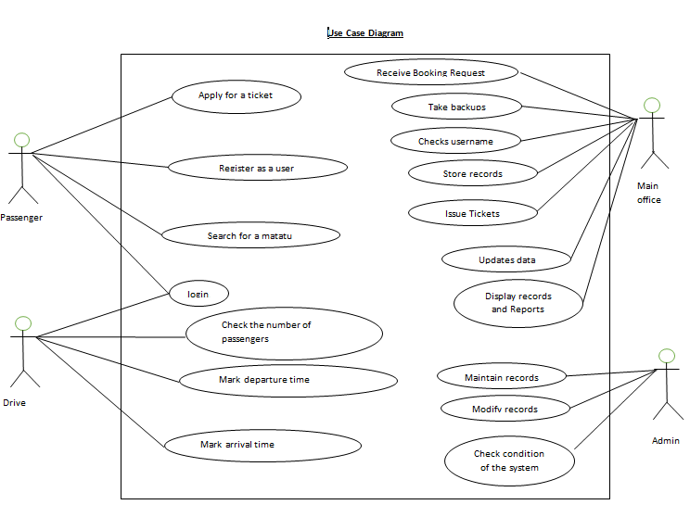

Slide 11
System requirements Non-functional requirements Product requirement
Efficiency requirements
With the computerized matatu system it will be easy to process
transport tickets
details should be updates faster in the database immediately after they are saved
Ease of retrieval of the saved data
Reliability requirements
The system should be accurate e.g.
when making the calculation and also in storing the calculated values.
when the matatu owners store data in the database the information should be stored immediately and the system automatically updates itself.
In cases where a stakeholder tries to register the system should validate that the details entered are correct and give a message that the one who want to login should continue else it should throw an error.

Slide 12
System requirements Cont’
Usability requirements
The matatu system will be designed in a way that it is user friendly in that all the users of the system will see it as easy to use.
This means that the messages that the system throws as errors should instruct the user on how to handle the prior error. For example
when a user enters wrong details which are not in the database during the login process the system should say you are not registered hence the user will know that he/she should register first

Slide 13
System requirements Organization requirement
Implementation requirement
In the coding of the matatu system we will use html, php, css, bootstrap and JavaScript. The database will be in MYSQL.
Delivery requirement
It is estimated that the system will be done in six months.
This means that after six months the system implementation and testing will be done and it will be ready to be presented to the market

Slide 14
System requirements External requirements
Legislative requirement
The matatu system is not against the Kenyan law, hence its implementation is not violation of the law.
The system will be copyright protected which means that it’s only the owner can give permission for other parties to get copies.
Lastly, the user will have to agree with the terms and the conditions under which the system will operate
Security requirement
The system will have different validations. For example
when one want to login he/she will have to have registered else cant access the system.
admin part of the system will be password protected.

Slide 15
Functional requirements Normal user
User registration
Description of features
This feature is where the customers / passengers will register to the system
Stimuli / response sequences
Stimuli: user runs the system
Response: the user is prompted to fill a registration form
Stimuli: the user fills the form and submits
Response: the system will verify if the details are in the database or not. If they are not the user will be registered. And if they are the user will be told to try again

Slide 16
Functional requirements Normal user
User login
Description of features
This feature is where the customers / passengers will login to the system
Stimuli / response sequences
Stimuli: user runs the system
Response: the user is prompted to input his/her user name and password
Stimuli: the user enters the username and password in the spaces provided
Response: the system will verify if the details are in the database or not. If they are the user will continue after the successful login and if they are not the user will not continue.

Slide 17
Functional requirements Normal user
Search a matatu
This is where one can get details about a specific matatu. One can search a matatu by
registration number
Model
number the number of passengers that the matatu carries
Stimuli / response sequences
Stimuli: user runs the system and click search matatu
Response: the system shows all the matatus that are in the system
Stimuli: the select which search criteria to use (the registration number, the ,model number the number of passengers that the matatu carries and also the model number.)
Response: the system on the other hand will bring the matatu details

Slide 18
Functional requirements Normal user
User book matatu
Description of features
This feature is where the customers / passengers will book a given matatu to very them to their destination
Stimuli / response sequences
Stimuli: user runs the system and clicks book matatu
Response: the system shows all the matatus destinations
Stimuli: the user select his/her destination
Response: the system shows the matatus that ferry to that destination and their prices per head.
Stimuli: the passenger selects which matatu to use and the number of seats that he/she will book and sets the price
Response: the system peaks the details and stores them in the database.if the booking is successful there should be an alert to inform the passenger that they have booked successfully.

Slide 19
Functional requirements Normal user
User password recovery
Description of features
This feature is where the customers / passengers and a the drivers will recover their lost password.
Stimuli / response sequences
Stimuli: user runs the system
Response: the user is prompted to input his/her user name and password
Stimuli: the user clicks “reset password”
Response: the system on the other hand had will send an email to the user from where to reset the password.

Slide 20
Admin
View matatu booking report
Description of feature
This feature a lows the admin of the matatu system to get the booking history of their matatus at any time or a period of time.
Stimulus / response sequence
Stimulus: The admin of the system selects a day from the date picker and select the type of booking that is either paid or unpaid booking
Response: the system will search the date picked transactions and show out the information.
Stimulus: the user can close the generated information or even print it as maybe reference.
Response: system will show print preview for the user.

Slide 21
Activity log
Description of feature
This feature records every process done by the users of the system. The feature records down the activities that they undertake like registering anew matatu to the system, changing details etc.
Stimulus / response sequence
Stimulus: The admin of the system selects activity log from the menu
Response: the system will search and retrieve the data and print on the screen.
Stimulus: the user can close the generated information or even print it as maybe reference.
Response: system will show print preview for the user.

Slide 22
View users
Description of feature
This feature should display all the registered users of the system
Stimulus / response sequence
Stimulus: The admin of the system selects view registered from the menu
Response: the system will retrieve the data and print on the screen.
Stimulus: the user can close the generated information or even print it as maybe reference.
Response: system will show print preview for the user.

Slide 23
TESTING.
Basically the main task is to ensure we have an error free system. The flow chart below shows the error tracking process.
Start
Tester: Report defects
Test Lead: validate defects
Dev. Lead: assign defects
Developer: fixes defects
Tester: retests the product
NO
Approved?
YES
Close defects
Stop

Slide 24
Cont..
Alpha Testing.
In this testing, we will test out the entire system with dummy data.
Unit testing.
Each of the modules in the System have to be tested to ensure they are working as required.
Integration testing.
In this testing, we ensure that the modules are working correctly hand in hand.

Slide 25
Cont.
User acceptance testing
this test focuses on validating the business logic. It allows the end users to complete one final review of the system prior to deployment. test done by end users

